Slide 1



Studying the Co-Construction of Interaction Protocols in Collaborative Tasks with Humans
Anna-Lisa Vollmer
Jonathan Grizou
Manuel Lopes
Katharina Rohlfing
Pierre-Yves Oudeyer
Notes:
Introducing myself
Today I would like to present to you work done in collaboration with Bielefeld university.
I will focus on presenting a new experimental setup for studying
the Co-Construction of Interaction Protocols in Collaborative Tasks with Humans
and I will also present the first results of a pilot study we conducted.

Slide 2
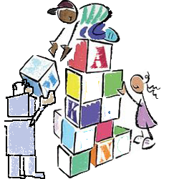
Aim: Flexible communication between humans and robots
Robots need to:
Understand unknown signals
Make sense of what they refer to
Agree with the partner on how to organize the interaction into roles and turns
Notes:
The overall general aim of this research is flexible communication between humans and robots
For robots to be able to learn from human instructions and for efficient human-robot collaboration
Some of the things Robots need to be capable of are for example
understanding unknown feedback or guidance signals
making sense of what they refer to depending on their timing an context
agree with the human partner on how to organize the interaction into roles and turns
To achieve this we first aim to understand the interactional flexibility of humans, how they align and how they create common ground.

Slide 3
Aim: Flexible communication between humans and robots
Robots need to:
Understand unknown signals
Make sense of what they refer to
Agree with the partner on how to organize the interaction into roles and turns
First step: Investigate how humans align and create common ground.
Notes:
The overall general aim of this research is flexible communication between humans and robots
For robots to be able to learn from human instructions and for efficient human-robot collaboration
Some of the things Robots need to be capable of are for example
understanding unknown feedback or guidance signals
making sense of what they refer to depending on their timing an context
agree with the human partner on how to organize the interaction into roles and turns
To achieve this we first aim to understand the interactional flexibility of humans, how they align and how they create common ground.

Slide 4
Aim: Flexible communication between humans and robots
Designing a new experimental setup.
Similar to Human-Robot interaction:
Asymmetric: humans and robots do not have the same perceptual capabilities
No shared interaction protocol
Humans might not know if and how exactly their signals are perceived by the robot
Notes:
Human communication is very complex, so we need an experimental setup with constraints that lower interactional complexity but still allows analyzing communication.
And we want to inform human-robot interaction on the long-run.
thus this setup should incorporate certain characteristics of human-robot interaction.
In this setup, communication should be asymmetric, as humans and robots do not perceive the world in the same way.
Additionally, human and robot might not have established a common protocol of interaction, and also
humans might not understand how exactly their signals are perceived by the robot.

Slide 5
The Co-co Game
Two players:
Joint construction task
Asymmetric roles
Restricted communication channels
Notes:
To investigate the processes humans use to negotiate a protocol of interaction when they do not already share one,
we came up with the Co-co game (coco stands for co-construction) which is played by two participants.
In the game, they have to complete a joint construction task together assuming asymmetric roles and communicating over restricted channels.

Slide 6
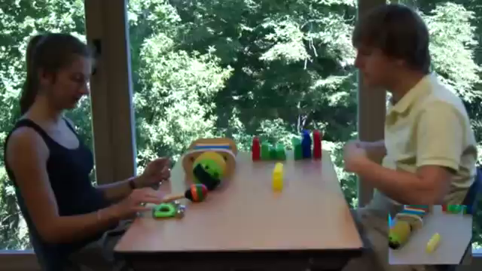
The Co-co Game
Notes:
To investigate the processes humans use to negotiate a protocol of interaction when they do not already share one,
we came up with the Co-co game (coco stands for co-construction) which is played by two participants.
In the game, they have to complete a joint construction task together assuming asymmetric roles and communicating over restricted channels.

Slide 7
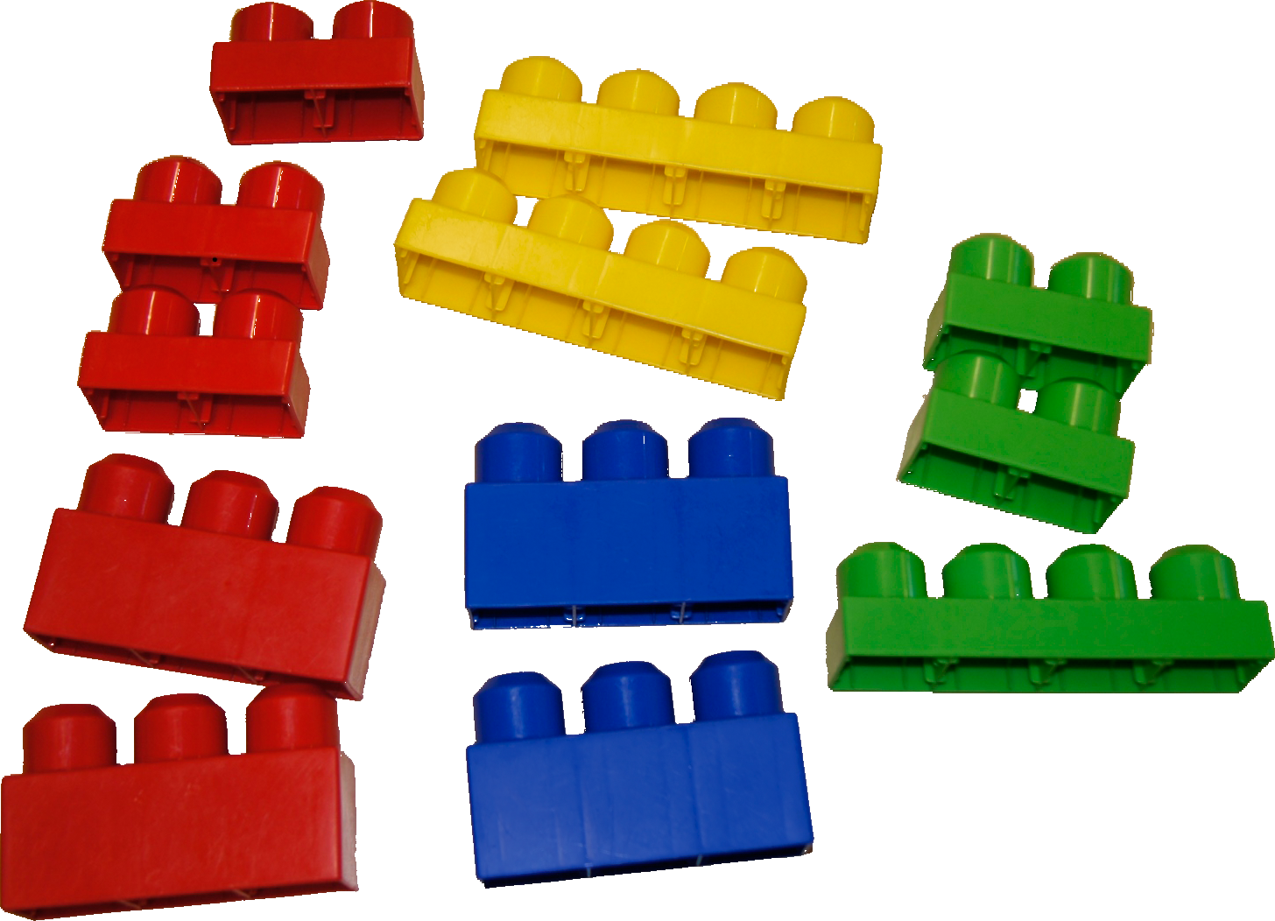
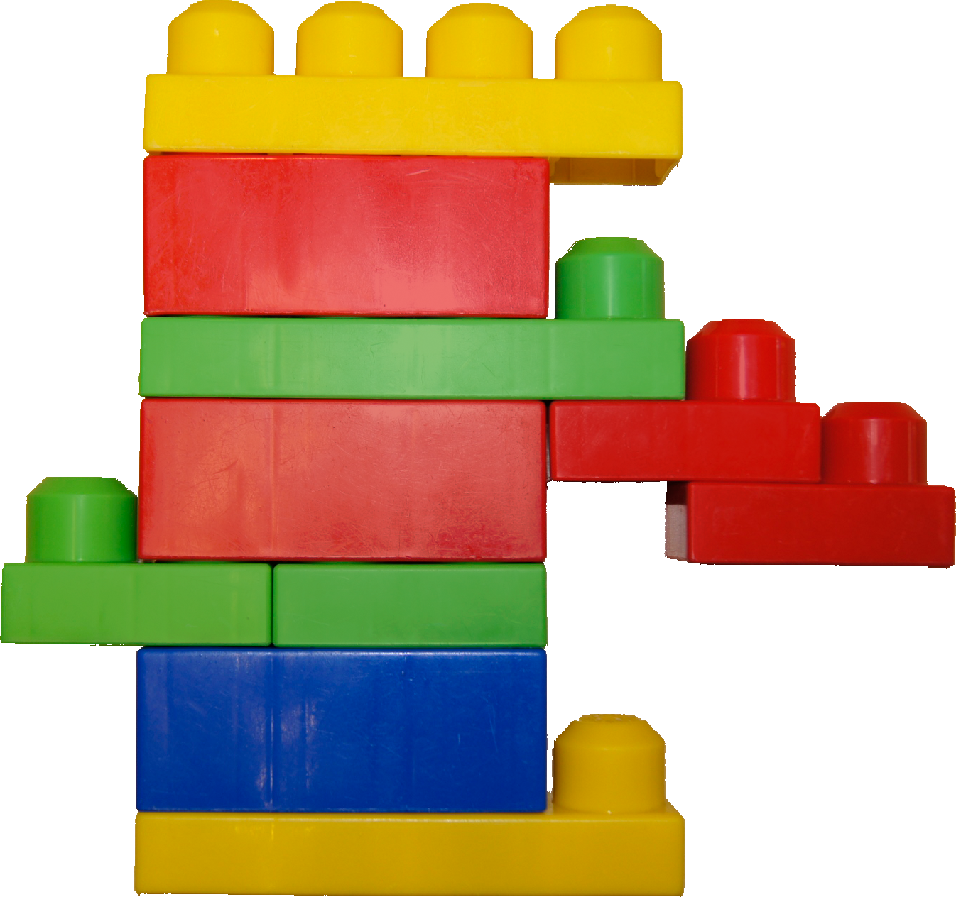
The Co-co Game
Joint construction task
Notes:
participants have to build a structure out of building blocks together

Slide 8
The Co-co Game
Asymmetric roles: builder and architect
builder architect
Notes:
they assume the role of a builder who has the building blocks and the role of an architect who knows what to build.

Slide 9
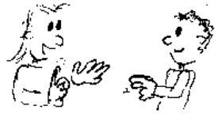
The Co-co Game
Restricted communication channels
builder architect
Notes:
but communication is not face-to-face

Slide 10

The Co-co Game
Restricted communication channels
builder architect
Notes:
that would be too easy, but it is restricted

Slide 11
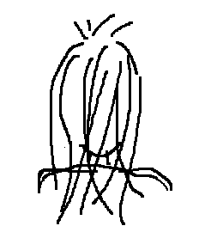

The Co-co Game – Setup
builder architect
wall
Notes:
so the setup looks as follows:
the builder and the architect sit in separate rooms. they do not see or hear each other

Slide 12


The Co-co Game – Setup
builder architect
wall
Notes:
the builder has the building blocks and the architect has an image of the target structure and thus knows what to build.

Slide 13


The Co-co Game – Setup
builder architect
wall
Notes:
each participant has a screen in his or her room.

Slide 14
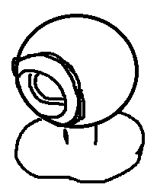
The Co-co Game – Setup
builder architect
wall
Notes:
the workspace of the builder is recorded via webcam and shown on the architect‘s screen.

Slide 15
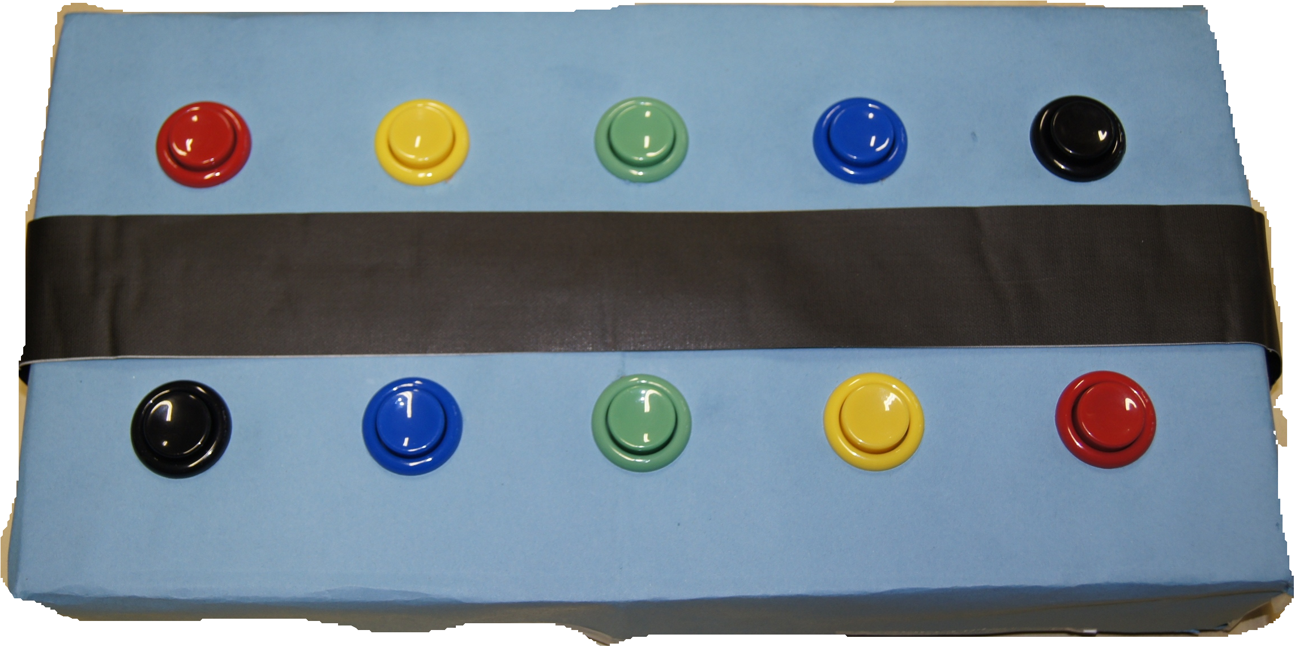
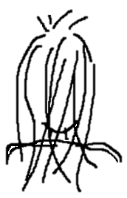
The Co-co Game – Setup
builder architect
wall
Notes:
in the other direction, the architect has a box with ten buttons with which he or she can communicate with the builder

Slide 16
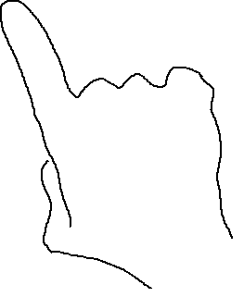
The Co-co Game – Setup
builder architect
wall
Notes:
when the buttons are pushed, they make symbols appear on the builder’s screen

Slide 17
The Co-co Game - setup
builder architect
wall
Notes:
joint construction task: building a structure out of building blocks together
asymmetric roles: builder and architect
restricted communication channels

Slide 18

The Co-co Game – Setup
Symbols:
Neutral (neither shape nor color are related to the task)
Button-symbol mapping arbitrary
Builders are told to avoid conventional gestures.
End: the builder decides that he/she has built the correct structure.
Notes:
The symbols are neutral and neither their shape nor color are related to the task. Each symbol has a fixed position for one game, but where the buttons are on the architect‘s box does not correspond to where the symbols are on the builder‘s screen. the players does not know this mapping
The game ends when the builder decides that he/she has built the target structure correctly.
All of what I just told you about the setup, we also told participants of the study before the game.
Additionally we told the builders they should not use conventional gestures
In the pilot, participants spoke aloud about the meanings associated to the symbols and buttons.

Slide 19
The Co-co Game – Pilot study
11 pairs of participants
7 pairs switched roles
b a b a
1 round excluded
Notes:
For the pilot study, 11 pairs of participants played the game, 7 of these pairs played the game for a second round for which they switched roles. so the architect in the first round was the builder in the second and vice-versa.
We excluded one round, because the architect did not stick to the target image.
Thus for the analysis we considered a total of 17 rounds.

Slide 20
The Co-co Game – Pilot study
succeeded failed
13 rounds successful, 4 failed.
Average duration: 18 min (min 17, max 45).
Notes:
Even though most participants before the game thought that they would never be able to succeed,
13 of the 17 rounds were successful and 4 failed.
a round took 18 minutes on average.
the fastest dyad only took 7 minutes and the maximum duration - at which we aborted the game - was 45 minutes.

Slide 21
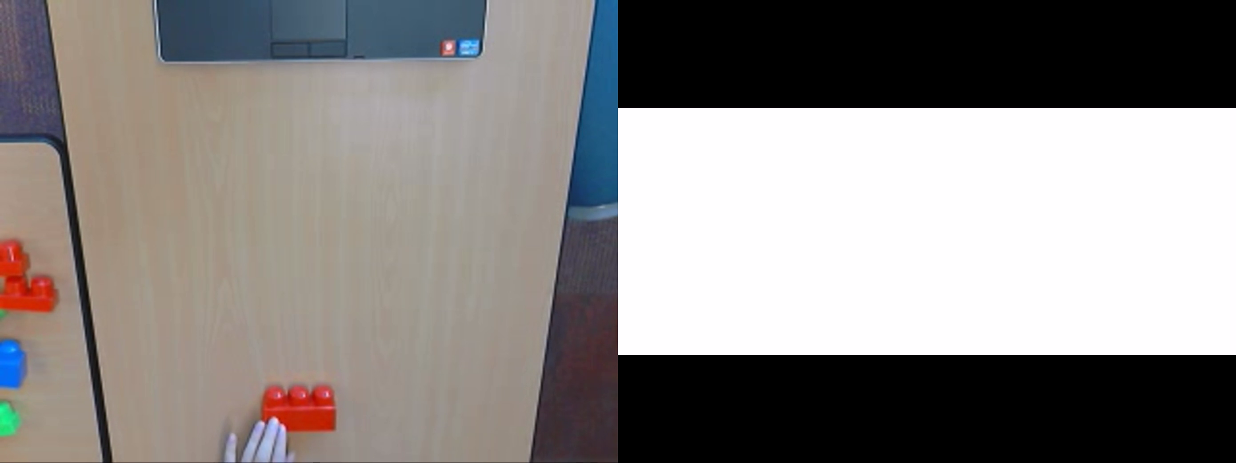
The Co-co Game – Pilot study
Notes:
The game sounds rather difficult in theory
Now I want to show you a video clip showing an excerpt from the beginning of a round
you are more than welcome to try to figure out what the architect is trying to tell the builder
it still seems difficult, if not to say hopeless
but in the end...

Slide 22
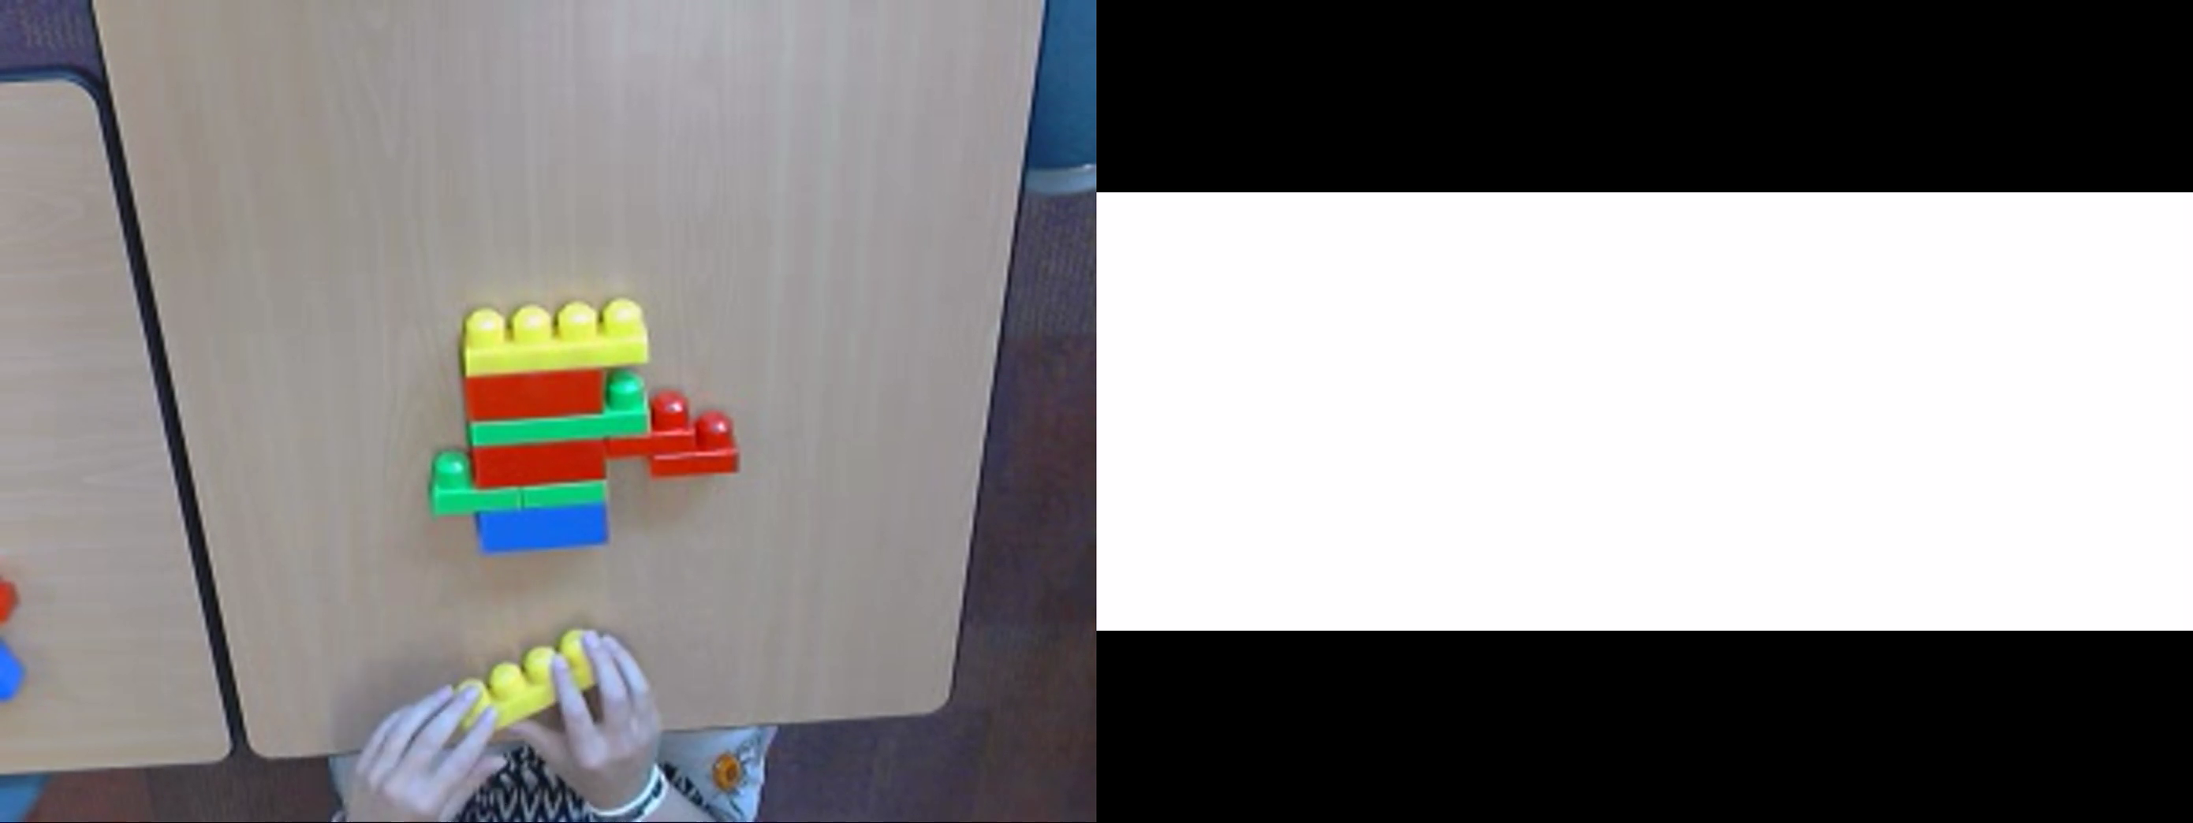
The Co-co Game – Pilot study
Notes:
...of the same round
communication is rather structured and most participant pairs do succeed.

Slide 23
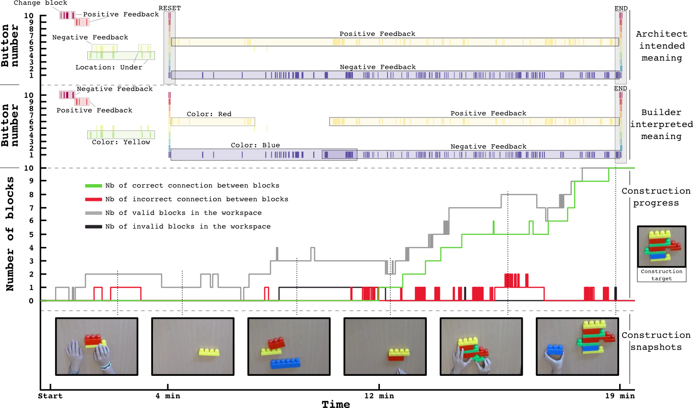
The Co-co Game – Pilot study
Notes:
here you see a visualization of the whole round I showed you in the video clips.
It contains information from architect and builder plotted against time.
on top you see the architect‘s button presses and their intended meanings. below you see what the builder thought these meant.
We see that in the first four minutes the architect is pushing many different buttons with different meanings which are not aligned with the builder‘s interpretation. Button 4 for example means under for the architect.
But this is not what the builder understands. for her the symbol appearing with Button 4 refers to the color yellow.
The architect seems to notice that something is going wrong and at four minutes pushes all buttons to signal a reset of communication. from this point on, He uses a simple yes/no strategy.
on the builder side this reset signal is followed by a long pause in actions which actually hints at a direct confusion. you can see that here on the bottom, where we have a progress graph showing how many correct (and incorrect) blocks and connections between blocks are in the builder‘s workspace. correct in gray and green and incorrect in red and black.
it is only at 12 minutes...
We observe a phase of confusion and negotiation at the beginning of the interactions and after that a completion phase in which signal meanings have been constituted.

Slide 24
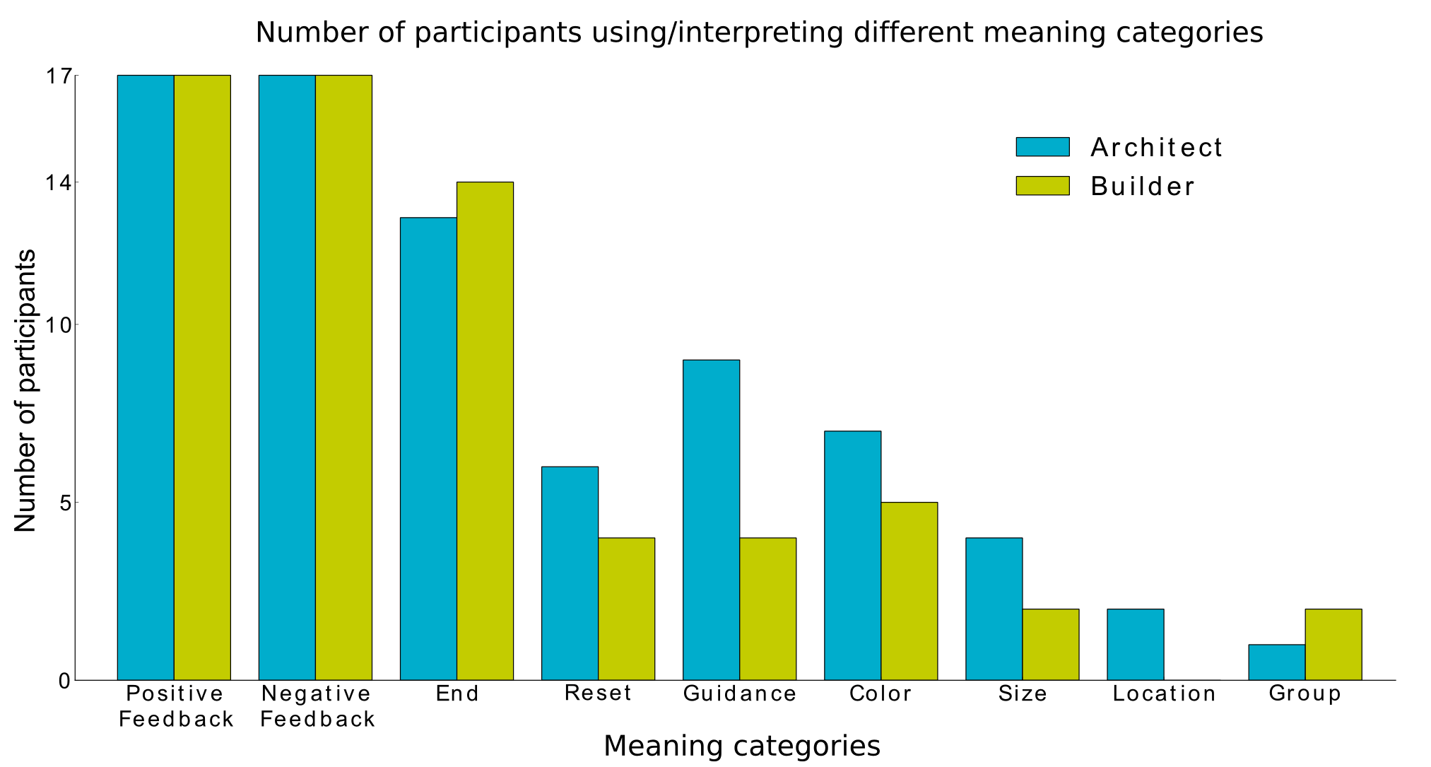
The Co-co Game – Pilot study
Notes:
for all 17 rounds, we looked at the types of meanings participants attributed to buttons and symbols
All participants considered positive and negative feedback.
Also the end signal was often used.
We also find a reset signal, guidance signals (which are instructions on what to do, such as change, invert, continue...), references to color or size of blocks, location signals such as right left above, under or signals referring to a certain group of blocks

Slide 25
The Co-co Game – Pilot study
Participants projected the interaction into different common frames of interaction and selected the one that was most coherent with the history of interaction.
The “feedback frame” seems the most commonly thought about and the easiest to understand in the context of our experiment.

Slide 26
The Co-co Game – Pilot study
When interacting, humans make use of frames and interaction protocols.
Frames:
Create a common ground about the purpose of the interaction
Help to understand communicative intentions of partner
Provide guidelines about how to behave (interaction protocol)

Slide 27
The Co-co Game – Pilot study
Main builder strategies:
Find one block and join right away, repeat
Find all blocks belonging to the structure, then start joining
No strategy
Notes:
The last analyses I presented focused on the meanings of buttons and symbols, that is on the architect‘s actions. The next slides are now about the builder‘s actions.
WE IDENTIFIED TWO MAIN BUILDER STRATEGIES, which I will show on the following slides,
but some builders also did not embark on any apparent strategy

Slide 28

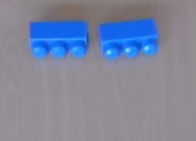

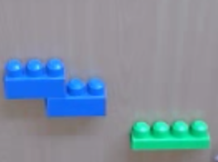
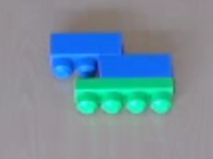
The Co-co Game – Pilot study
Find one block and join right away, repeat
...
Number of rounds: 12 Successful: 11, Failed: 1
Notes:
The most common strategy for builders was to find one correct block at a time and then to subsequently find the correct position to join it with the rest of the structure
builders in 12 of the 17 rounds pursued the same strategy. only one of these failed (say why)

Slide 29

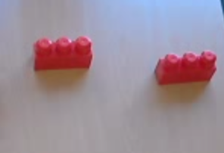
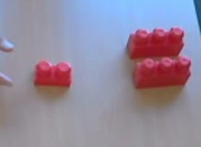
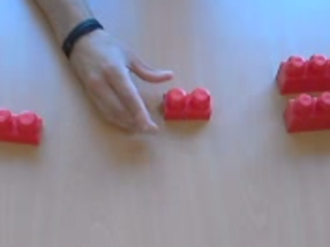
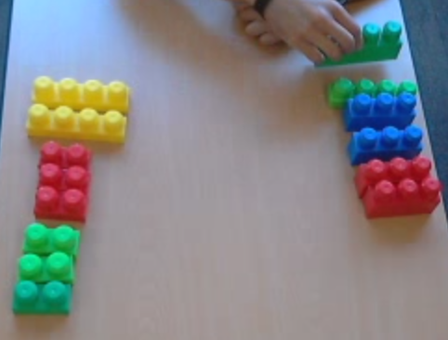
The Co-co Game – Pilot study
Find all blocks belonging to the structure, then start joining
... ... 1.
Number of rounds: 2 Successful: 2, Failed: 0
Notes:
The other strategy was to one at a time find all blocks belonging to the target structure by dividing the blocks into two groups.
then correct blocks were joined in a next step.
This strategy was pursued by two builders in two successful rounds.

Slide 30
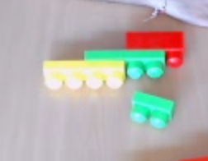
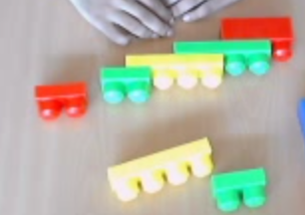
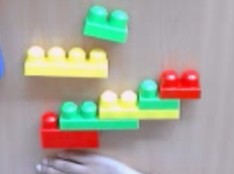
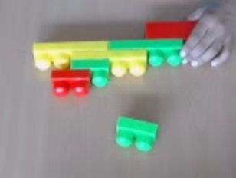
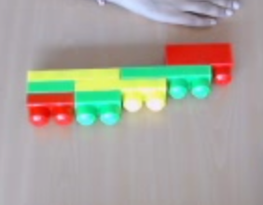
The Co-co Game – Pilot study
3. No strategy
...
Number of rounds: 3 Successful: 0, Failed: 3
Notes:
three builders presented multiple (sometimes even joined) blocks at a time throughout the game.
Their rounds all failed. with an end structure nowhere near the target structure.
thus, the way the builders propose next steps and ask for information from the architect seems to be important for the success of the game.
Builders seem to build frames and create slots for the architect’s input. These frames are the context in which the signals are intrepreted.

Slide 31
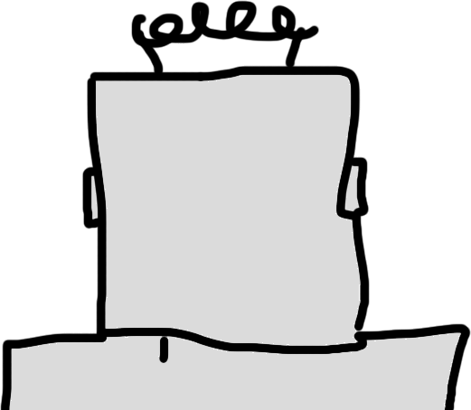
The Co-co Game – Human-Robot Interaction
builder architect
wall
Notes:
If we want to replace the builder by a robot – not programmed in advance on how to understand human communication and without a specific preprogrammed rigid interaction protocol –

Slide 32
The Co-co Game – Human-Robot Interaction
Equip the robot with
A set of common interaction frames
A mechanism of proposition of frames to elicit appropriate signals from a human tutor
Notes:
we should equip the robot with a set of common interaction frames on which it can rely to find one that is coherent with the interaction history.
a mechanism of proposition providing frames with slots for the architect to give information in a learning robot could be a means to elicit appropriate signals from a human tutor in HRI.

Slide 33
Thank you for your attention
Questions ?

Slide 34
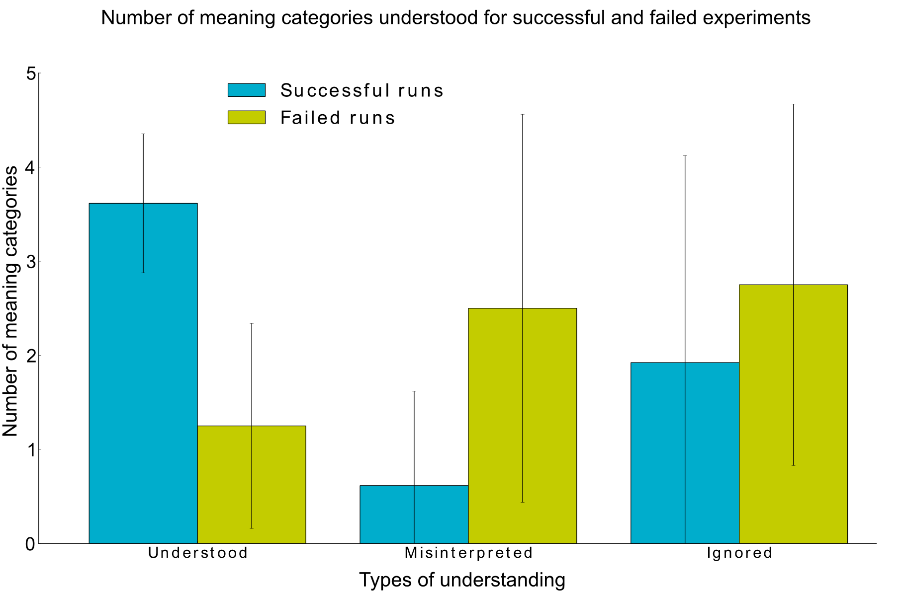
The Co-co Game – Pilot study
Notes:
Then we wanted to know about the amount of shared understanding between players in a round and if it was more in successful than in unsuccessful rounds.
For successful rounds, the average number of signals understood that is those where architect and builder agree on a common meaning is 3.6, Interestingly for failed rounds, this number drops to 1.3, with a larger amount of signals for which architect and builder reported different meanings (misinterpreted) and signals which the architect but not the builder mentioned (ignored).

Slide 35
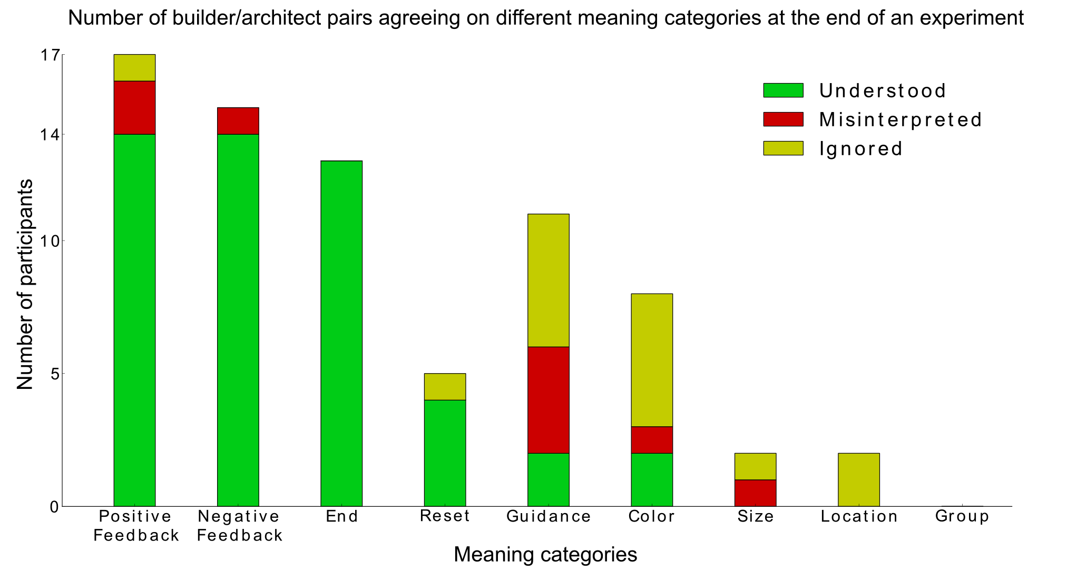
The Co-co Game – Pilot study
Notes:
Next we were interested in what meanings exactly most pairs agreed on.
These were Positive feedback, Negative feedback, End, and occasionally Reset when needed.

